Slide 1
CGB1221 – DATABASE MANAGEMENT SYSTEM PROJECT REVIEW
Department of Artificial Intelligence and Data Science
Academic Year: 2024 – 2025 (Even Semester)
Register Number : 2303811724322116
Name : TAMILDEEPAA A
Year : II
Semester : IV
Section : B
Date : 04/06/2025

Slide 2
Title of the Project
SUPERMARKET BILLING SYSTEM

Slide 3
Abstract
The Supermarket Billing System is an automated solution designed to streamline billing and inventory operations in a retail environment.
It replaces manual processes with a database-driven platform that manages product details, customer records, transactions, and payments

Slide 4
Introduction
The Supermarket Billing System addresses this need by providing a comprehensive tool to handle product sales, billing, inventory tracking, and customer service.
This system aims to build a digital platform that reduces manual workload and increases operational transparency.

Slide 5
DBMS - Concepts Used
Relational Database Management System (RDBMS): It organizes data into structured tables.
Primary and Foreign Keys: It enforce data relationships and integrity.
Normalization: It reduces data redundancy and improves efficiency.
SQL Queries: It used for data manipulation and retrieval.

Slide 6
Proposed Architecture - Description
Start : The system begins with a welcome page or login screen, prompting users (Admin or Cashier) to authenticate before accessing the dashboard.
Add Customer : Allows entry of new customer details including name, contact number, email, and address (linked via zipcode). The customer is registered for future billing and record purposes.
Add Product: Enables the admin to add new products to the inventory. Inputs include product name, model ID, type, price, and starting quantity.

Slide 7
Proposed Architecture - Description (Cont..)
Update Product Quantity: Allows the admin to update stock levels—either by restocking or adjusting quantities after audits. This ensures accurate inventory management.
Create Bill (Billing Process): The cashier selects or registers a customer, adds items to the cart by model ID, and generates the total bill. The system calculates amounts automatically using stored procedures.

Slide 8
Proposed Architecture - Description (Cont..)
Update Product Quantity: Allows the admin to update stock levels—either by restocking or adjusting quantities after audits. This ensures accurate inventory management.
Create Bill (Billing Process): The cashier selects or registers a customer, adds items to the cart by model ID, and generates the total bill. The system calculates amounts automatically using stored procedures.

Slide 9
Proposed Architecture - Description (Cont..)
Remove Product: Enables deletion of discontinued or damaged products from the inventory. This keeps the product list clean and current.
Process Payment: Captures the payment details for the generated bill. Includes payment mode (cash/card) and records the date and amount. The payment is linked to the bill and customer.
Exit: Safely logs out the user and ensures that all recent changes (inventory updates, new entries, payments) are saved to the database.

Slide 10
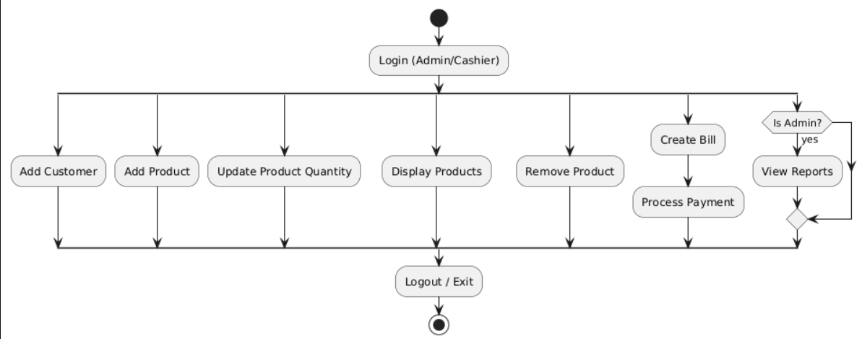
Proposed Architecture

Slide 11
List of Modules
Customer Management Module
Product and Inventory Module
Billing and Cart Module
Payment Module
Employee Management Module

Slide 12
Module Description (Cont..)
Customer Module:
This module is responsible for managing all customer-related information in the supermarket billing system.
It ensures that customer details are securely stored, linked with transactions, and easily retrievable for billing and reporting purposes.
Key Functions: Add,Update,View,Delete

Slide 13
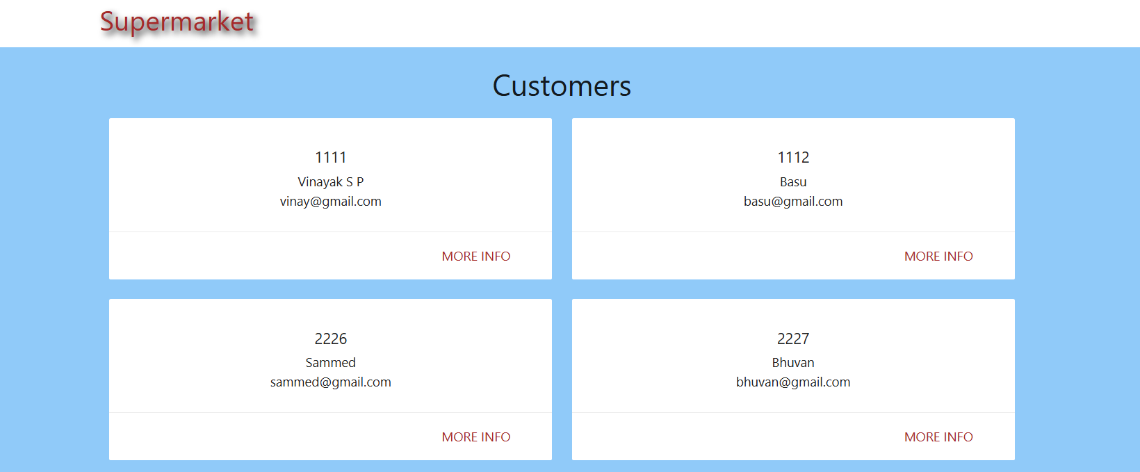
Module Description (Cont..)

Slide 14
Module Description (Cont..)
Product & Inventory Module:
This module is central to managing all products sold in the supermarket.
It handles product categorization, pricing, and stock quantity. It ensures accurate inventory tracking and supports real-time updates during billing and restocking operations.
Key Functions:Add,Update,Display,Remove.

Slide 15
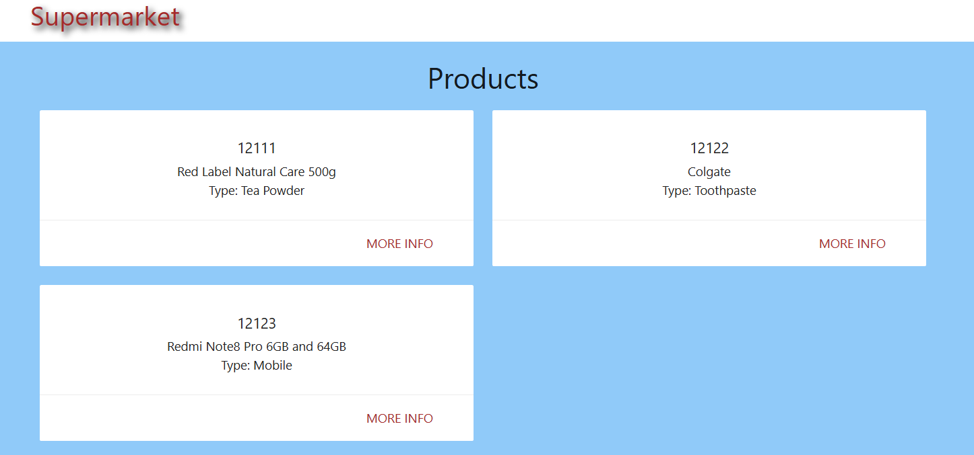
Module Description (Cont..)

Slide 16
Module Description (Cont..)
Billing Module:
This module is the core component of the Supermarket Billing System. It facilitates the generation of bills for customer purchases, manages cart data, and ensures that the inventory is updated in real time.
It handles all operations from item selection to final bill creation and links transactions with both customers and employees.

Slide 17
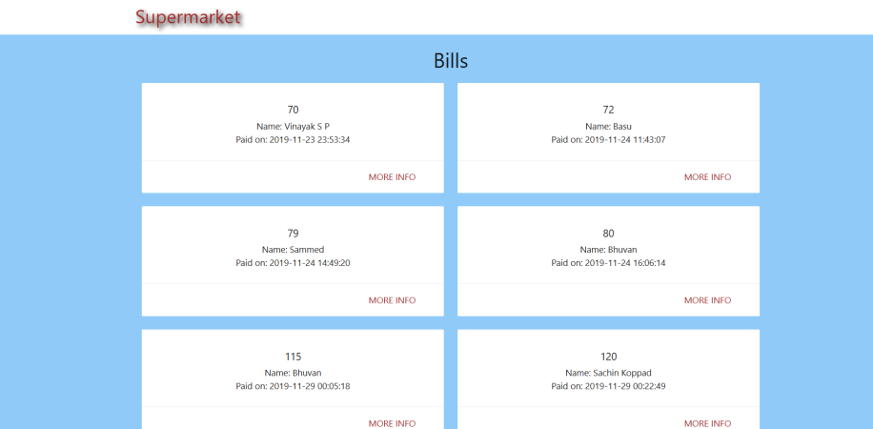
Module Description (Cont..)

Slide 18
Module Description (Cont..)
Payment Module:
This module handles the financial transactions that occur after a bill is generated. It records the payment amount, method, date, and associates the payment with a specific customer and bill.
It ensures that all transactions are traceable and securely stored for reporting and audit purposes.

Slide 19
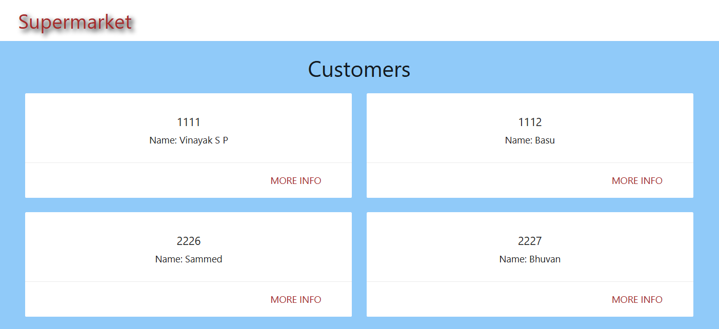
Module Description (Cont..)

Slide 20
Module Description (Cont..)
Employee Module:
This module is responsible for storing and managing information related to all employees working in the supermarket. It includes roles such as billers, volunteers, and security staff.
It ensures proper assignment of responsibilities, tracks who handled specific transactions, and supports secure role-based system access.

Slide 21
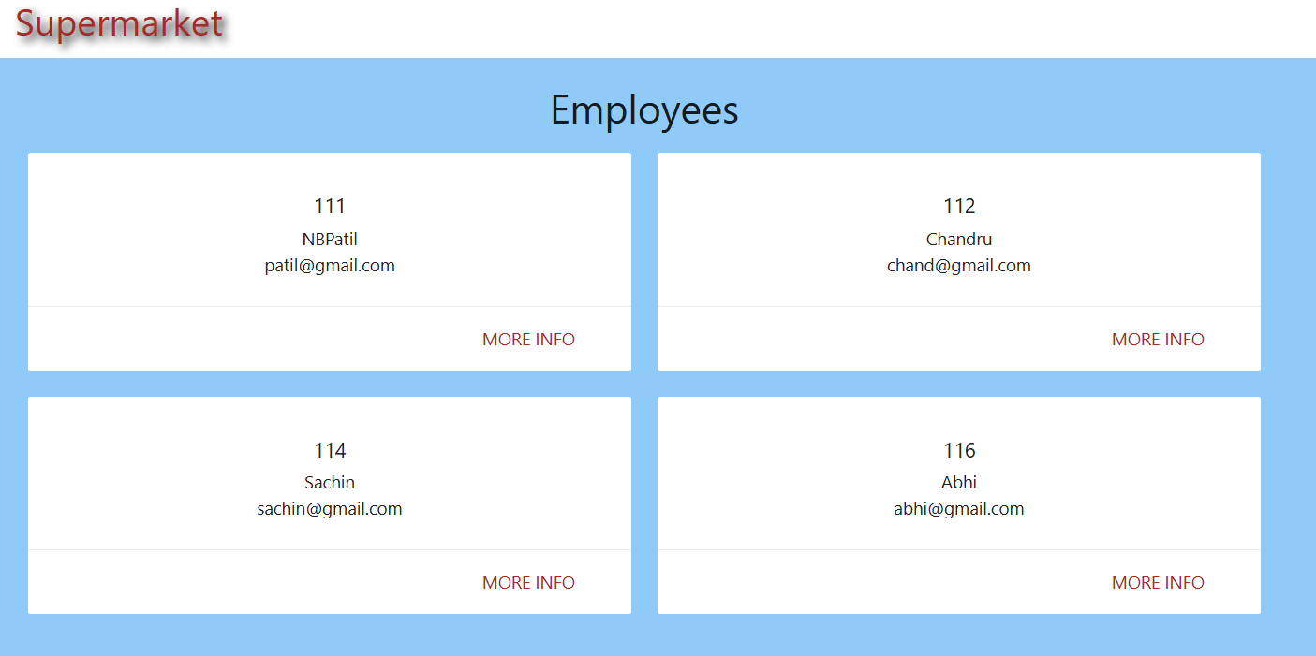
Module Description (Cont..)

Slide 22
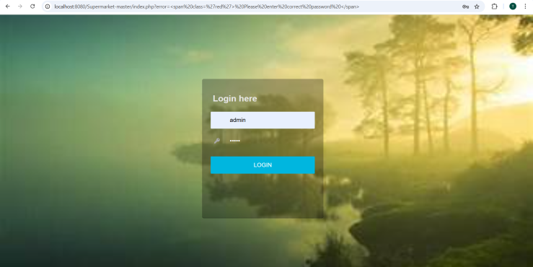
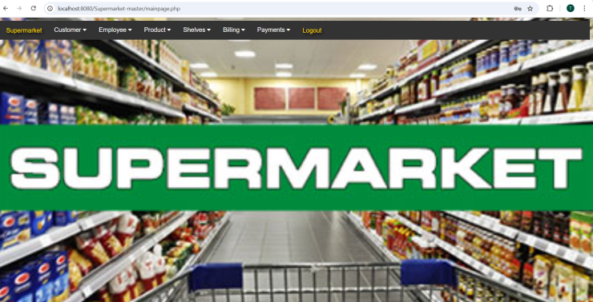
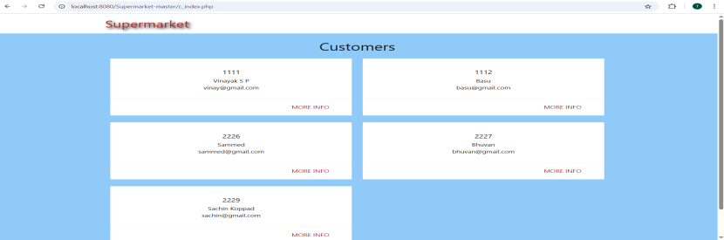
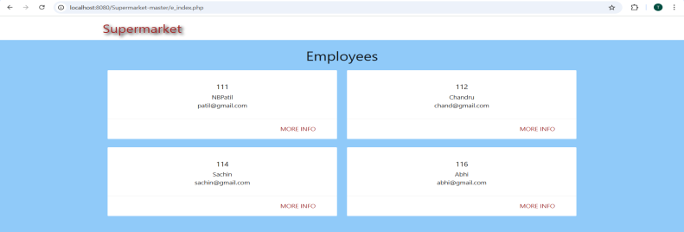
OUTPUT

Slide 23
Conclusion
The Supermarket Billing System successfully automates and integrates key retail functions including billing, inventory, and customer management. By leveraging DBMS features like triggers, constraints, and procedures, it ensures accurate, real-time operations. The system is scalable and can be extended to include analytics, mobile apps, and advanced reporting in the future, making it a strong foundation for modern retail management.

Slide 24
THANKYOU

